Slide 1
ITMD 421 – Data Modeling and Applications
Aastha Gupta
Lecture 2
August 28, 2017

Slide 2
Objectives
Database Life Cycle
Why conceptual modeling?
Introduction of the Key role players:
Entities
Attributes
Relationships
E-R diagrams and examples

Slide 3
Database Life Cycle
Database Design is a collection of processes that facilitate the designing, development, implementation and maintenance of database management systems.
Meet requirements of the users
Have high system performance
Produce physical and logical design models of the proposed database management systems.

Slide 4
Database Life Cycle
Requirement Analysis
Planning
Database Designing
Logical Model
Implementation
Data Conversion and loading
System definition
Physical Model
Testing

Slide 5
Database Life Cycle
Requirement Analysis
What is going to be stored?
How is it going to be used?
What are we going to do with the data?
Who should access the data?
Scope of the proposed system?
Technical and Non-technical people are involved

Slide 6
Database Life Cycle
Conceptual Design/Logical Model
High-level description of the database.
Sufficiently precise that technical people can understand it
The entire design is on a piece of paper
This is where Entity-Relation model fits in
Physical Model
This stage takes the physical factors in consideration.
The physical design step involves the selection of indexes (access methods), partitioning, and clustering of data.

Slide 7
Database Life Cycle
Implementation
The database design is created through implementation of the formal schema through structured query language.

Slide 8
Why Create a Conceptual Model?
It describes exactly the information needs of the business
It facilitates discussion
It helps to prevent mistakes, misunderstanding
It forms important “ideal system” documentation
It forms a sound basis for physical database design
It is a very good practice with many practitioners

Slide 9






Between Dream and Reality...

Slide 10
Entity Relationship Modeling
The ER model defines the conceptual view of a database.
Models business, not implementation
Is a well-established technique
Has a robust syntax
Results in easy-to-read diagrams...although they may look rather complex at first sight
It works around real-world entities and the associations among them.
At view level, the ER model is considered a good option for designing databases.

Slide 11
Goals of Entity Relationship Modeling
Capture all required information
Information appears only once
Model no information that is derivable from other information already modeled
Information is in a predictable, logical place

Slide 12
Entity Relationship Diagram
An Entity Relationship (ER) Diagram is a type of flowchart that illustrates how “entities” such as people, objects or concepts relate to each other within a system.
ER Diagrams are most often used to design or debug relational databases in the fields of software engineering, business information systems, education and research.

Slide 13
Entity Relationship Diagram
ER Models, use a defined set of symbols such as rectangles, diamonds, ovals and connecting lines to depict the interconnectedness of entities, relationships and their attributes.
They mirror grammatical structure, with entities as nouns and relationships as verbs.
This process is iterated many times
Name
Name
Price
Category
Product
makes
company

Slide 14

Interlude: Impact of the ER model
The E/R model is one of the most cited articles in Computer Science
“The Entity-Relationship model – toward a unified view of data” Peter Chen, 1976
Used by companies big and small
You’ll know it soon enough

Slide 15
Entity
An entity can be a real-world object, either animate or inanimate, that can be easily identifiable.
Something” of significance to the business about which data must be known
A name for the things that you can list
Usually a noun

Slide 16
Entity
For example, in a school database, students, teachers, classes, and courses offered can be considered as entities. All these entities have some attributes or properties that give them their identity.
Examples: objects, events

Slide 17
Entity Representation in Diagram
Drawn as a “rectangle”
Name singular
Name inside
Neither size,
nor position has a
special meaning
During design, entities usually lead to tables.
EMPLOYEE
JOB
ELECTION
TICKET
RESERVATION
ORDER
JOB ASSIGNMENT

Slide 18
Entities and Sets
An entity represents a set of instances that are of interest to a particular business.
An entity set is a collection of similar types of entities. An entity set may contain entities with attribute sharing similar values. For example, a Students set may contain all the students of a school; likewise a Teachers set may contain all the teachers of a school from all faculties.

Slide 19
Entity keys
A key is a minimal set of attributes that uniquely identifies an entity.
Super Key
Candidate Key
Primary Key
Foreign Key
The E/R model forces us to designate a single primary key, though there may be multiple candidate keys
Name
Price
Category
Product

Slide 20
Primary Key
A primary is a column or set of columns in a table that uniquely identifies row in that table.
Student ID- | Student First Name | Student Last Name | Student Email Address | Student Phone Number
A203467 | John | Smith | jsmith@iit.com | 785-524-2574
A679345 | Greg | Linton | glinton@iit.com | 457-789-1453
A452813 | Aastha | Gupta | agupta56@iit.edu | 143-781-2654

Slide 21
Primary Key
The primary key is denoted by underlining the column name.
Primary key cannot contain duplicate values.
They cannot contain NULL values.
It can be denoted by one or more than columns from the table.
Which one is better: Student_id or {Student_id, Student_firstname}

Slide 22
Primary Key
There are 2 ways to chose your primary key:
Either to create a column and let database automatically have numbers in increasing order for each row
OR choose a column from the table that does not contain duplicates and nulls.

Slide 23
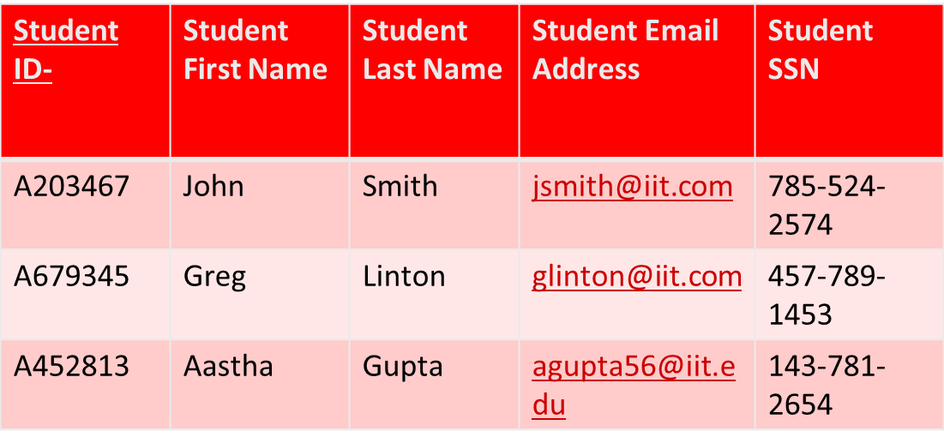
Super Key
A super key is a set or one of more columns to uniquely identify rows in a table.

Slide 24
Super Key
Super Key
{Student_id}
{Student_SSN}
{Student_id,Student_SSN}
{Student_id,Student_FirstName}
{Student_id,Student_LastName}
{Student_SSN,Student_FirstName}
{Student_SSN,Student_LastName}
{Student_id,Student_SSN,Student_FirstName}

Slide 25
Candidate Key
A super key with no redundant attribute is known as candidate key. Candidate keys are selected from the set of super keys.
Candidate key is also termed as minimal super key.
Candidate Keys
{Student_id}
{Student_SSN}
A primary key is selected from the group of candidate keys.

Slide 26
Composite Key
A key that consists of more than one attribute to uniquely identify rows in a table is called composite key. It is also known as compound key.
Composite Keys
{Student_id,Student_SSN}
{Student_id,Student_FirstName}
{Student_id,Student_LastName}
{Student_SSN,Student_FirstName}
{Student_SSN,Student_LastName}
{Student_id,Student_SSN,Student_FirstName}

Slide 27
Foreign Key
Foreign keys are the columns of a table that points to the primary key of another table.
Course_Id | Student Id | Course Name
C12 | A203467 | SQL
C56 | A679345 | Web
C37 | A203467 | Testing
In this example the Student Id column in Course Enrollment table is a foreign key as it points to the primary key of the Student table.

Slide 28
Entity categories
Strong Entity
Entities having its own attribute as primary keys are called strong entity.
Weak Entity
Entities which cannot form their own attribute as primary key are known weak entities. These entities will derive their primary keys from the combination of its attribute and primary key from its mapping entity.

Slide 29

Entity categories
Example
Class
Class_id
Class_Name
Section
Section_id
Section_Name
Class_id
This is an example CLASS and SECTION entity. The SECTION has SECTION _ID and NAME as its attribute; however SECTION _ID alone cannot be a primary key.

Slide 30
Attribute
Always answers “of what?”
Is the property of entity, not of relationship
Must be single valued
Has format, for example:
Character string
Number
Date
Picture
Sound
Is an elementary piece of data

Slide 31
Attribute
Also represents something of significance to the business
Is a single valued property detail of an entity
Is a specific piece of information that:
Describes
Quantifies
Qualifies
Classifies
Specifies an entity

Slide 32
Attribute Types
Composite Attribute
They can be divided into smaller subparts with independent meanings.
Example:
Address van be subdivided into street address, city, state, zip
Simple Attribute
They are not divisible.
Example
Student_id, SSN

Slide 33
Attribute Types
Single Valued Attribute
They have only one value.
Example:
Social Security Number
Multi Valued Attribute
They may contain more than one values.
Example:
Phone Number
Email address

Slide 34
Attribute Types
Derived Attribute
They are the attributes that do not exist in the physical database, but their values are derived from other attributes present in the database.
Example:
Age
Stored Attribute
The attribute which gives the value to get the derived attribute are called Stored Attribute.

Slide 35
Attribute Types
Complex Attribute
These attribute types can come together in a way
simple single-valued attributes
Student_id
simple multi-valued attributes
Phone number
composite single-valued attributes
Date of birth
composite multi-valued attributes
Shop address at two different locations.

Slide 36
Attributes in Diagrams
Mandatory attribute, that is, known and available for every instance.
Optional attribute, that is, unknown or unimportant to know for some instances.
During design, attributes lead to columns.
EMPLOYEE Family Name Address Birth Date Shoe Size Email
JOB Title Description

Slide 37
Relationships
Also represent something of significance to the business
Express how entities are mutually related
Always exist between two entities (or one entity twice)
Always have two perspectives
Are named at both ends
During design, relationships lead to foreign keys.

Slide 38
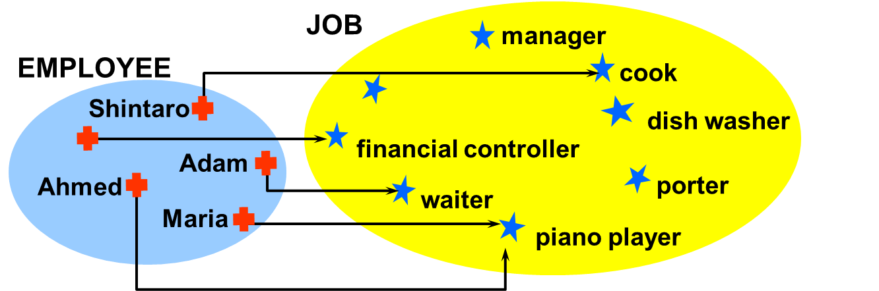
Relationship Examples
Numerical observation:
All EMPLOYEES have a JOB
No EMPLOYEE has more than one JOB
Not all JOBS are held by an EMPLOYEE
Some JOBS are held by more than one EMPLOYEE

Slide 39
Degree of Relationship
The number of participating entities in a relationship defines the degree of the relationship.
Binary
Ternary
N-ary

Slide 40
Mapping Cardinality
Defines the numerical attributes of the relationship between two entities or entity sets.
The are of three main types
One-to-one (1:1)
One-to-many (1:N)
Many-to-many (N:N)
Many-to-one (N:1)
1
1
1
N
N
N
N
1

Slide 41
One-to-one Relationship
EMPLOYEE
MANAGES
DEPARTMENT
e1
e2
e3
e4
e5
e6
e7
e8
r1
r2
r3
r4
d1
d2
d3
d4

Slide 42
Many-to-many Relationship
EMPLOYEE
WORKS ON
PROJECTS
e1
e2
e3
e4
e5
e6
e7
e8
r1
r2
r3
r4
r5
r6
r7
p1
p2
p3
p4

Slide 43
Many-to-one Relationship
CUSTOMER
PLACES
ORDERS
c1
c2
c3
c4
c5
c6
r1
r2
r3
r4
r5
r6
r7
o1
o2
o3
o4
o5

Slide 44
Participation
Total participation
Each entity is involved in the relationship. Total participation is represented by double lines.
Partial participation
Not all entities are involved in the relationship. Partial participation is represented by single lines.

Slide 45
ER Diagram Symbols
Entities:
Rectangles are used to represent the entity in the diagram.
A strong entity is represented by simple rectangle
A weak entity is represented by two rectangles.

Slide 46
ER Diagram Symbols
Attributes:
An oval shape is used to represent the attributes.
Multivalued attributes are represented by double oval shape.
derived attributes are represented by oval shape with dashed lines
A composite attribute is also represented by oval shape, but these attribute will be connected to its parent attribute forming a tree structure.
An underline to the attribute name is put to represent the primary key. The key attribute of the weak entity is represented by dashed underline.

Slide 47
ER Diagram Symbols
Relationships:
An underline to the attribute name is put to represent the primary key. The key attribute of the weak entity is represented by dashed underline.
A mapping with weak entity is shown using double diamond.

Slide 48
Example
Let us create a simple ER diagram for a STUDENT database. What is the requirement of this database?
Student attends class.
Each class is divided into one or more sections.
Each class will have its own specified subjects.
Students have to attend all the subjects of the class that he attends.

Slide 49
Example
Entities
Student
Class
Section
Subject

Slide 50
Example
Attributes
Student
Student_id
Student_Name
Address
DOB
Age
Class_id
Section_id
Class
Class_id
Class_Name
Section
Section_id
Section_Name
Subject
Subject_id
Subject_Name

Slide 51
Example
Relationships
Attends
Has section
Have subjects
Studies subjects

Slide 52
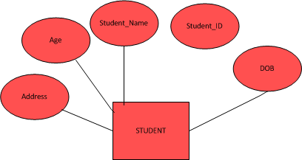
ER Diagram
Entity Student

Slide 53
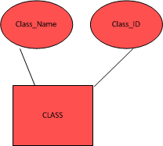
ER Diagram
Entity Class

Slide 54

ER Diagram
Entity Section

Slide 55

ER Diagram
Entity Subject

Slide 56
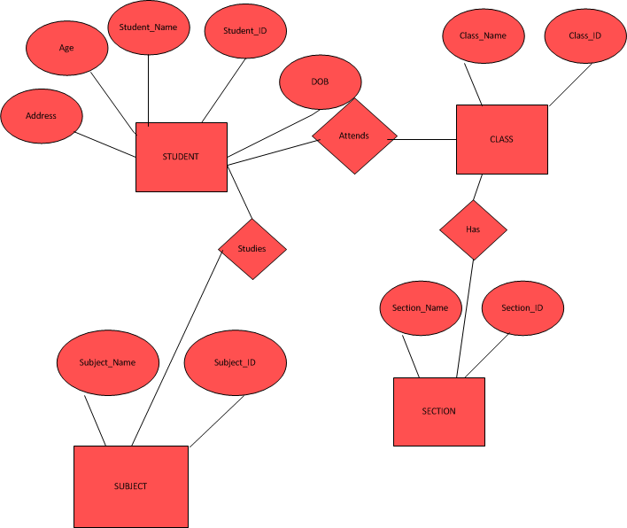
ER Diagram
Add Relationships

Slide 57
ER Diagram
Observations
Age is a derived attribute
Address is a composite attribute.
There is no relation between section and student; section is a weak entity.
Participation constraints
All students can attend any one of the class but a class can have a fixed number of students.
All the class has section and all the section has class. Hence both are total participation.
All the Students study some of the subjects specific for their class and each class has only some group of subjects. Hence partial participation of both STUDENT and CLASS. Each subject will be studied by some students and it will be part of some class. Hence this also partial participation.

Slide 58
ER Diagram
Cardinality
Each Student attends only one class at a time. Hence it is a 1: 1 relation.
Each class has one or more sections. Hence it can be considered as 1: N relation.
Each student attends many subjects and each class has many subjects. Hence it is a 1:N relation.

Slide 59
ER Diagram
Cardinality
Each Student attends only one class at a time. Hence it is a 1: 1 relation.
Each class has one or more sections. Hence it can be considered as 1: N relation.
Each student attends many subjects and each class has many subjects. Hence it is a 1:N relation.

Slide 60
ER Example 2
There is a database conference in Chicago area. During this event large number of conferences are taking place.
Each workshop has a name, speaker, date and room.
A participant can assign up for one or more workshops.
A participant shares his name, email and the workshop he/she wish to attend to complete registration.
There are number of rooms where the workshops will take place. Each room is identified by the floor and room number.
Every workshop must be allocated no more than one room, even if it runs for more than one day.

Slide 61
…
Speaker
P_Name
W_Name
Date
P_ID
W_ID
Workshop
Has
Participants
In
Email_add
Room
Room_No
R_Name
Floor

Slide 62
ER Example 3
Lets take an example of an ordering system
Each customer can place order
Order details contain order name, shipping address, date the order was placed, shipping date.
A order can be comprised of one of more items.
An item can be ordered by one of more customers.
Items are shipped from a warehouse.

Slide 63
…
Shipping_add
Cust_Name
Contact
Cust_ID
Customer
Item_Name
Item_ID
Place
Fulfills
Warehouse
Order_ID
Order
Item_Qty
Order_Date
Shipping_Date

Slide 64
ER Example 4
Draw a normal form ER diagram for a university library information system which stores information about books, journals, publishers, students, staff, borrowing of books, and reservation of books. Note that the library may have more than one copy for some of the books.

Slide 65
…
PID
Publisher
P_Name
Contact
P_Loc
Book_ID
Publish
Publish
Journal_ID
Journal
J_Qty
Book
B_Qty
J_Date
B_Name
J_Name
DOI
ISBN
B_Date
B_author
J_author
Issues
Reserve
Stud_Name
Staff_Name
Stud_ID
Staff_ID
Iss_Date
Due_Date
Student
Staff
Stud_Dept
Staff_Dept

Slide 66
Transforming Tables
Conceptual Model
Relational Model

Slide 67
Technology Mapping
All entities are converted into tables.
Single valued attributes are converted into columns of the table.
Key attributes are the primary keys of that table.
In case of relationships, define foreign keys.
Multi valued attributes are converted into new tables.
Composite attributes are merged with same tables but with different columns.
Derived attributes can be ignored.

Slide 68
Technology Mapping
ANALYSIS
DESIGN
ER Model
Physical Design
Entity
Table
Attribute
Column
Primary UID
Primary Key
Secondary UID
Unique Key
Relationship
Foreign Key
Business Constraints
Check Constraints

Slide 69
Specialization and Generalization
Generalization
Specialization

Slide 70
Specialization and Generalization
Generalization occurs when we ignore the differences and acknowledge the similarities between lower entities or child classes or relations (tables in DBMS) to form a higher entity.
Specialization occurs when we spilt a higher entity to form lower entities, then we discover the differences between those lower entities.

Slide 71
Generalization
Chair
Table
Couch
Furniture

Slide 72
Specialization
Person
IS A
Teacher
Student

Slide 73
Summary
E/R diagrams are a visual syntax that allows technical and non-technical people to talk
For conceptual design
Basic constructs: entity, relationship, and attributes
A good design is faithful to the constraints of the application, but not overzealous

Slide 74
Thank You
Assignment 1 is posted on Blackboard.
Due Date : Monday, September 4th
Be sure that your name and “Assignment 1” appear at the top of your submitted file.
THANK YOU!

